Slide 1
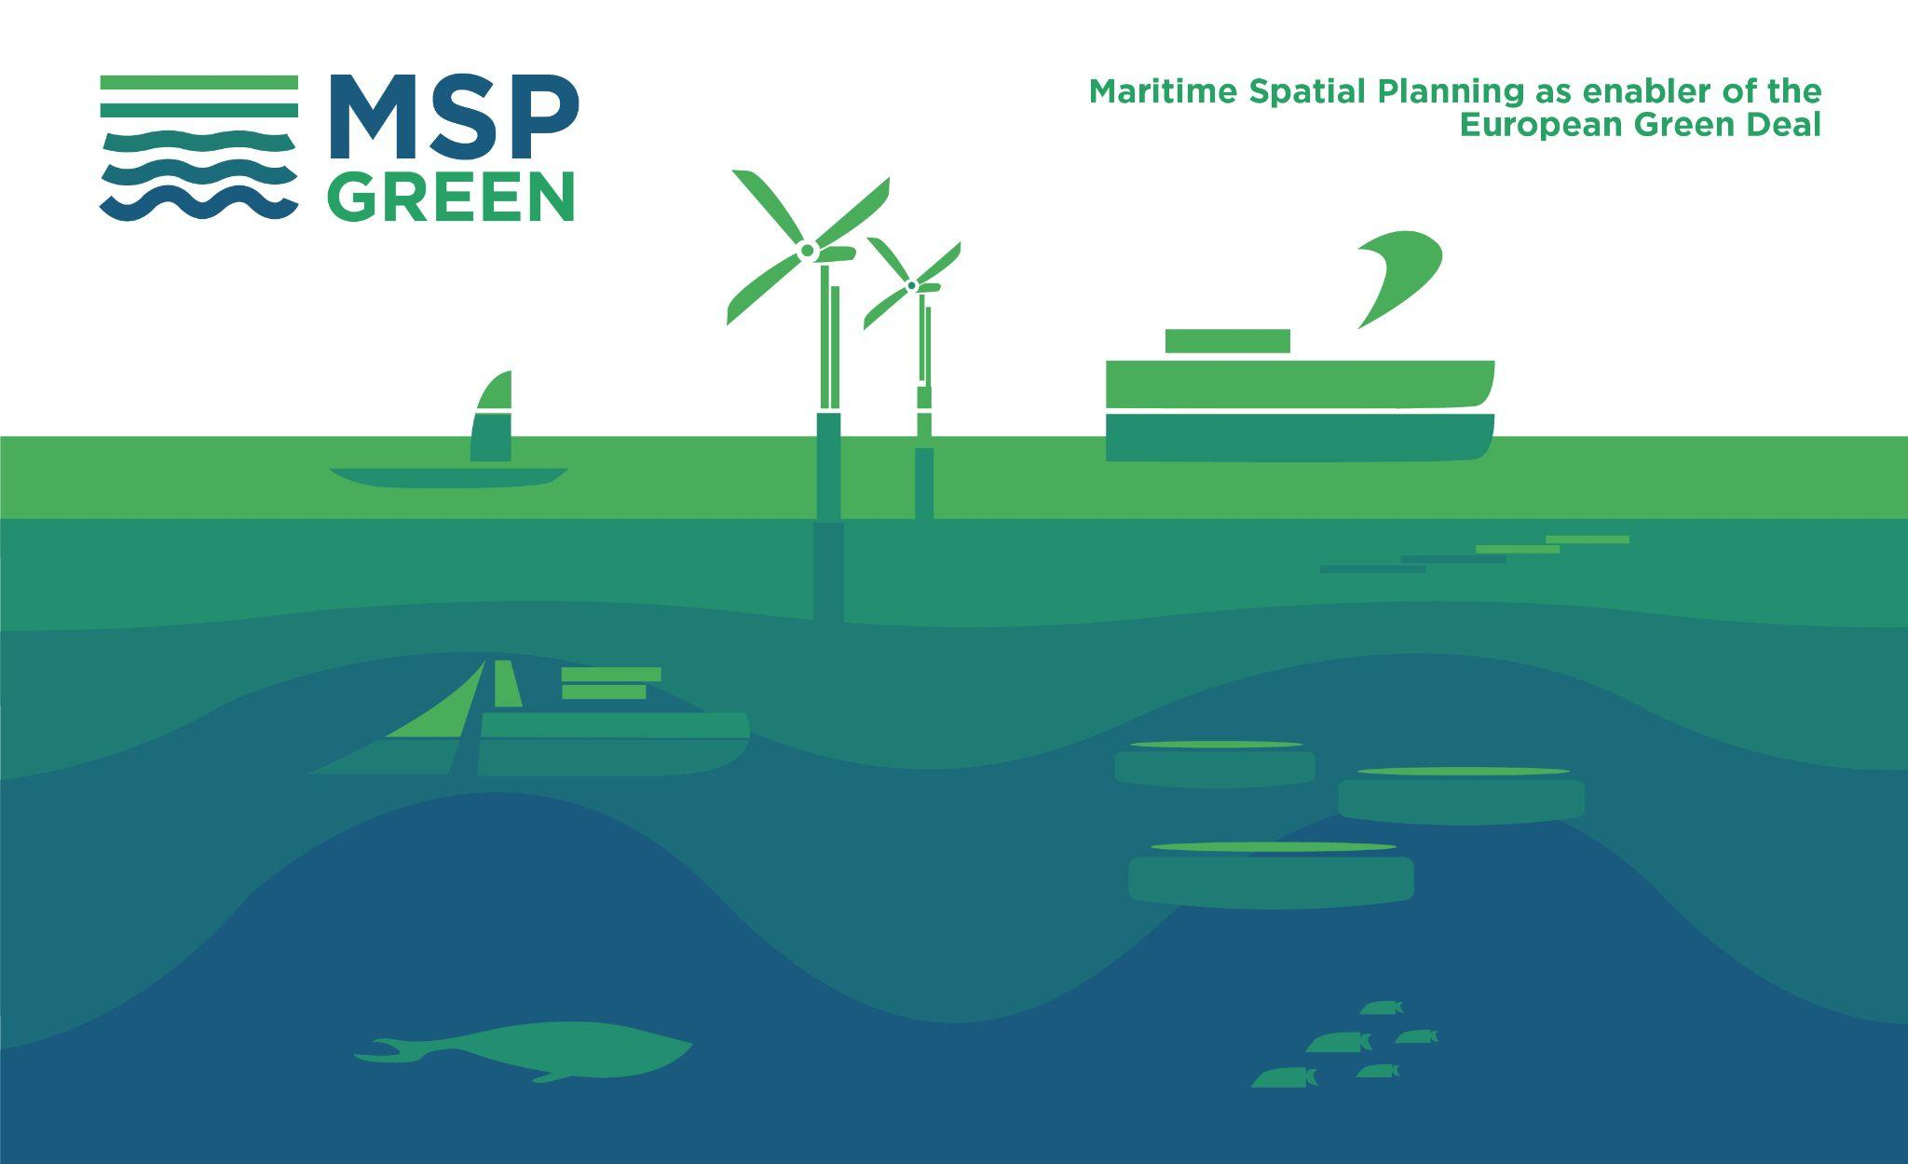

Slide 2
Occasion, Date
MSP-GREEN
Objectives and scope
Presenter

Slide 3
MSP-GREEN
Scope
5 Basins: Mediterranean Sea, Atlantic Ocean, Baltic Sea, North Sea, Black Sea
Full Partners: CORILA, CEREMA, UBO, CSIC, MoEPRD, FI RCSW, CCMS.
Duration: 2 years, starting November 2022
Affiliated Entities IUAV, CNR-ISMAR, IFREMER
Associated Partners: VASAB, BSH.
Budget: 1.933.490,03 €

Slide 4
OBJECTIVE OF THE PROJECT
The MSP-GREEN project contributes to align maritime spatial plans to the ambition of the EGD by creating a framework for plans as marine enablers of the EGD.
The framework will provide a cross-cutting approach to the EGD key topics relevant for marine environment and sustainable transition of blue economy: climate change, circular blue economy, marine biodiversity, sustainable food provision, zero pollution.
Recommendations on how to strengthen the EGD ambition of EU MSP plans will be prepared.

Slide 5
SPECIFIC OBJECTIVES
Assess whether and how MSP plans have considered the EGD objectives
Assess what are the major gaps, challenges and trade-offs in mainstreaming EGD into MSP
Identify and exchange valuable practises of incorporation of EGD elements in MSP plans
Identify, design and start implementing additional actions to strengthen the implementation of EGD-related objectives
Provide recommendations to EU countries on how to use MSP in fostering the achievement of the EGD goals
Engage regional sea communities – including non-EU countries in a dialogue on the EGD ambition and the role of marine planning for a Sustainable Blue Economy

Slide 6
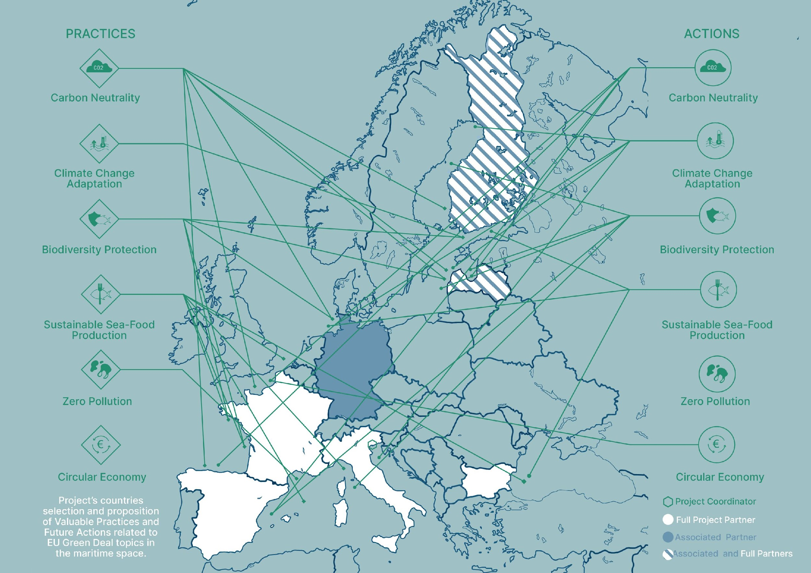
Agenda of the Kick-off meeting
Text
Space for institutional logo

Slide 7
MAIN SCOPE OF OPERATIONAL WPs
in a nutshell
The project will analyze MSP plans and legislations in a EGD view. (WP2)
It will identify best practices and new possible actions on key EGD topics, liasing with blue sectors. (WP3)
It will allow the share of knowledge and experiences across countries and 5 basins. (WP4)
It will allow study of maritime cultures at basin level in a EGD communication perspective. (WP5)

Slide 8
OPEN TO DIALOGUE and CO-OPERATION
The European and World scenes are changing fast
Climate change effects are measurable and are becoming severe
Time is NOT an independent variable
Wrong ways & deadlocks must be avoided
Helping each other, co-operate is a bare necessity
And we are starting today

Slide 9
Notes:
Contact details

